Slide 1


Open House
West Mecklenburg High School
Fall, 2023

Slide 2
Please complete this form so we can update your contact information
Parent Contact

Slide 3
WELCOME TO
WEST MECKLENBURG

Slide 4
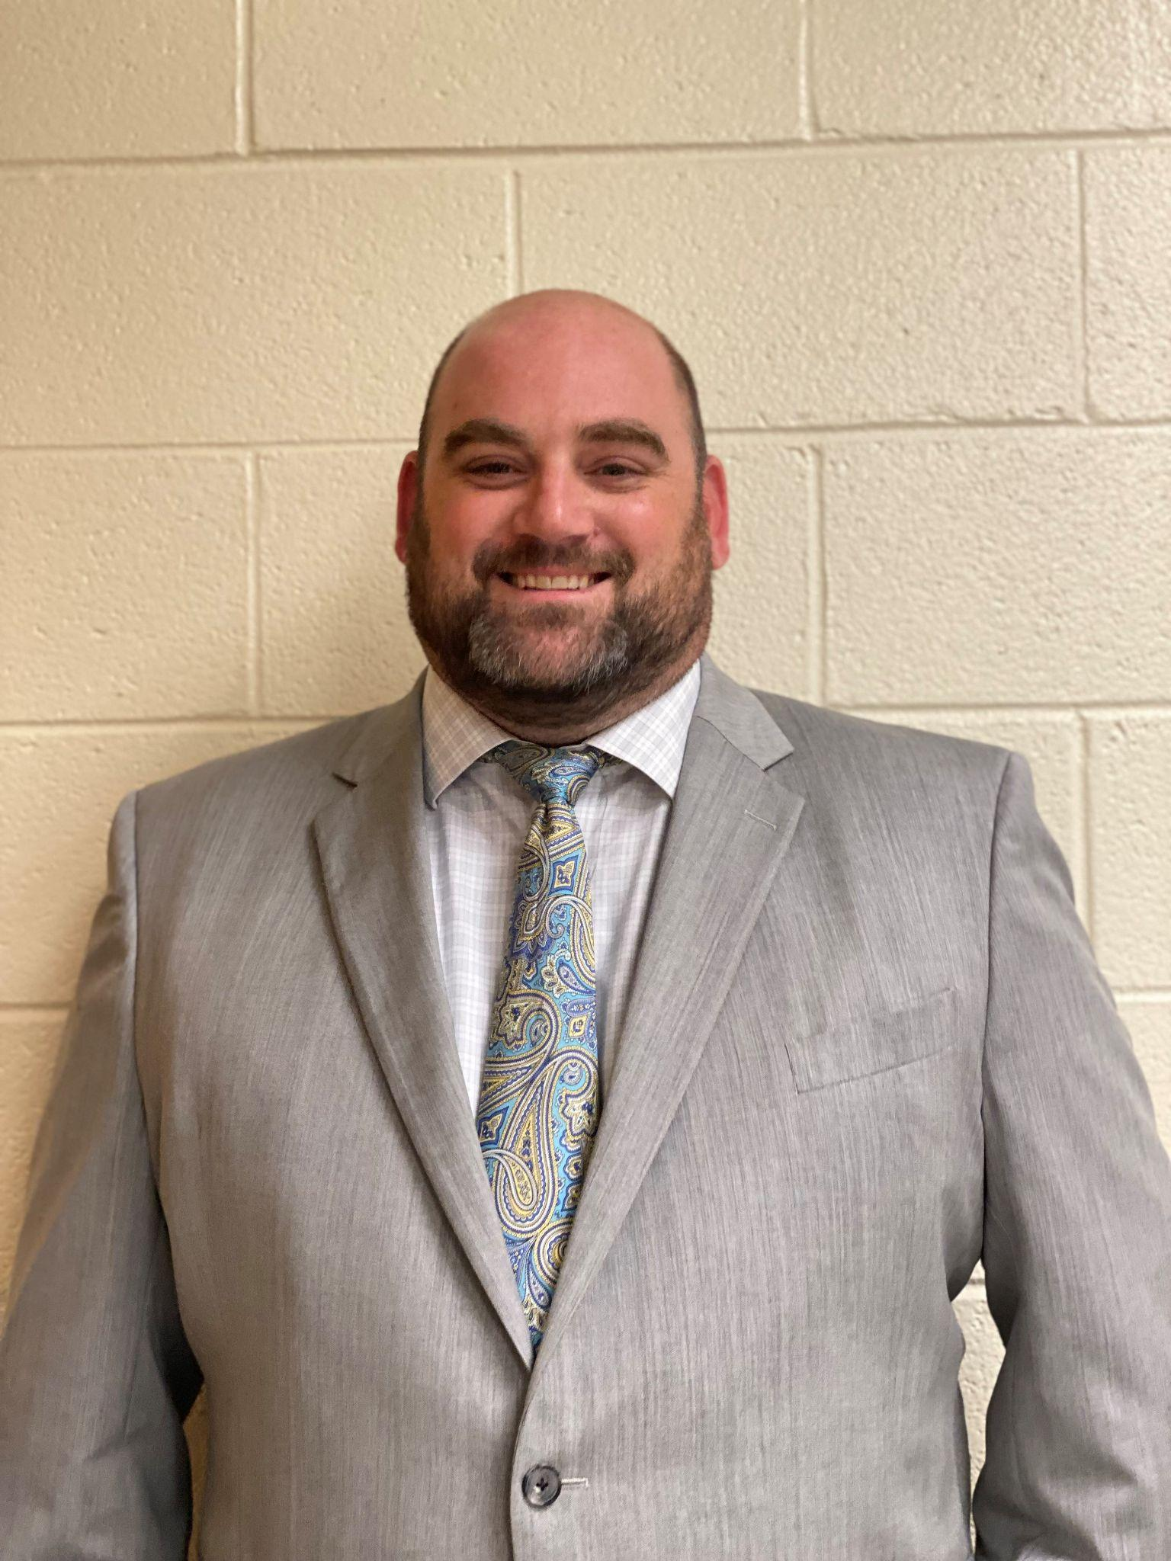

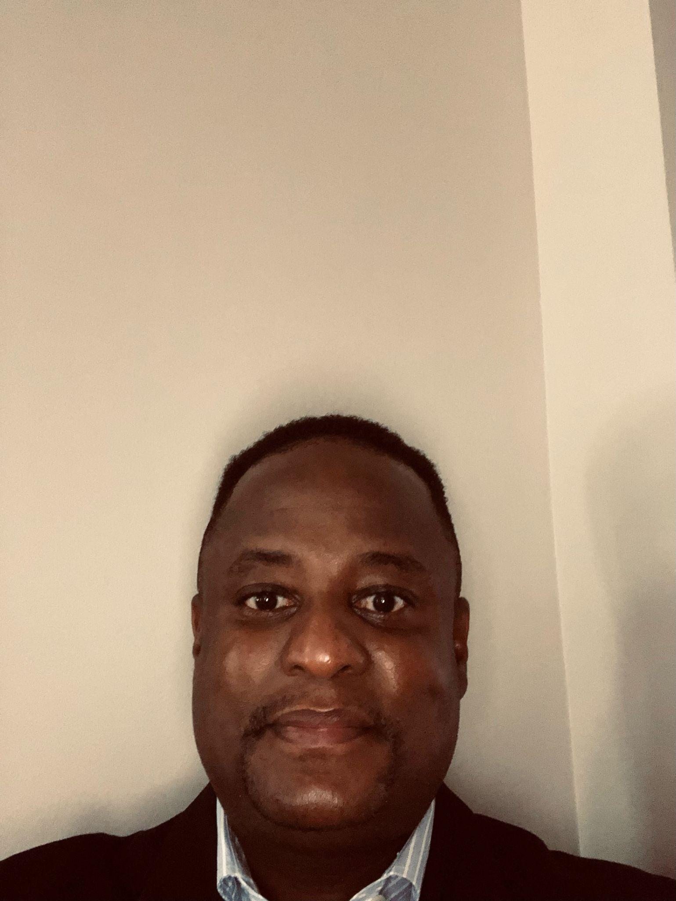
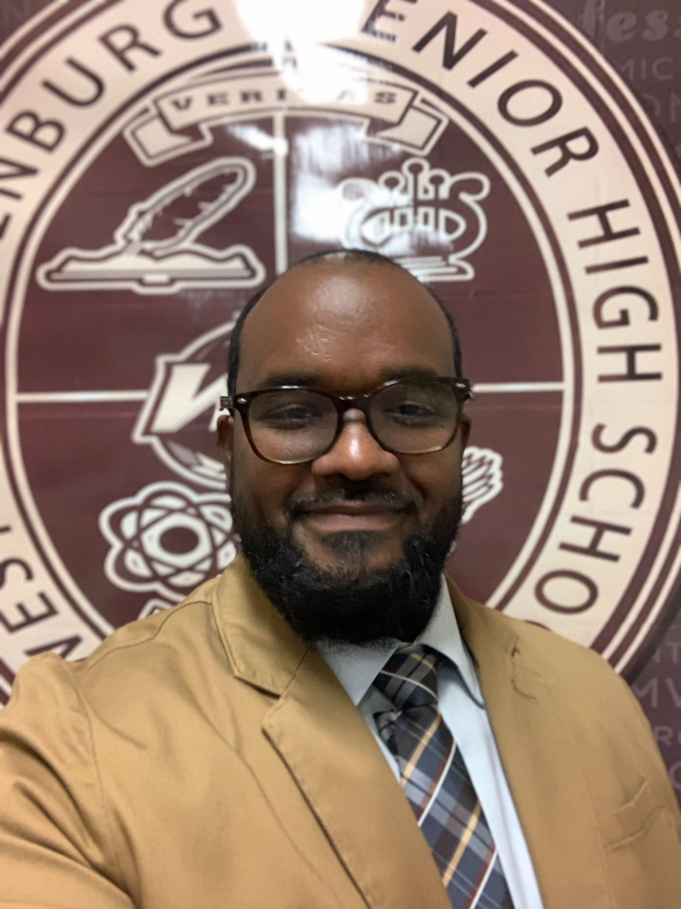
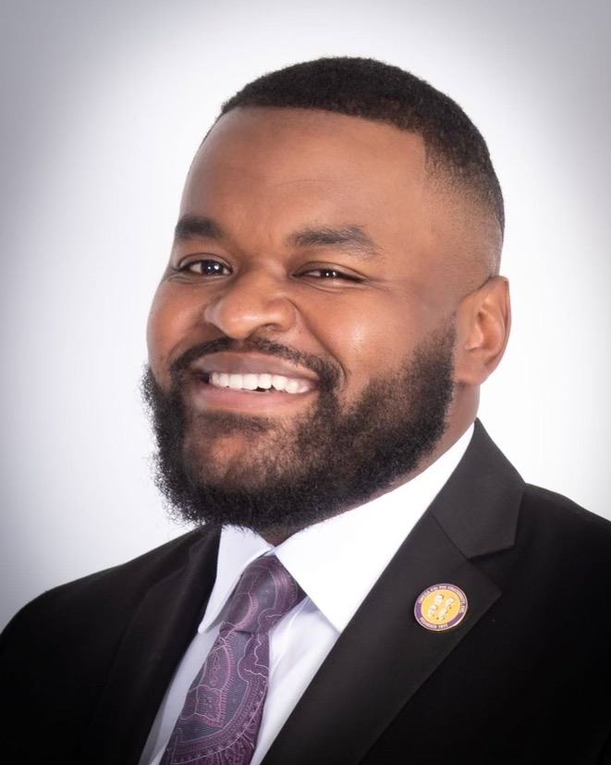
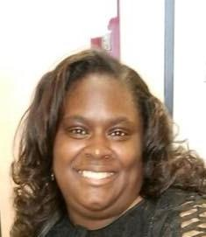
Introducing your Leadership team
Mr. CASIMIR BUNDRICK
Mr. Wendell Evans
Assistant Principal
Principal
Mr. Lawrence Peoples
Assistant Principal
Mr. Daniel Monroe
Dean of Students
MRS. ANNISSA JOHNSON-ANTHONY
Assistant Principal

Slide 5

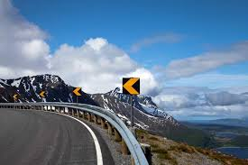
Goals vs. Guardrails:
What are they? What is the difference?
Goals are the tangible things we are working to achieve this school year and next school year. Goals are inplace to make sure we are have a destination in mind to help shape and inform the work.
Guardrails are the things that we cannot violate to achieve our goals. In other words, the guardrails keep us focused on equitable work that, if done with impact, will allow us to reach our goals.

Slide 6
District Goals and Guardrails Overview
Goal 2: The percent of high school students who score at the College and Career (CCR) level -- a 4 or 5 -- in Math 1 (grades 9-12) will increase from <5% (4.5%) in October 2021 to 25% in October 2024.
Goal 3: The percent of graduates earning a state high school endorsement will increase from 61.2% in June 2021 to 75% by June 2024.
Goal 4: The percent of schools who met or exceeded expected Educator Value Added Assessment System (EVAAS) growth will increase from 71.7% in October 2019 to 95% by October 2024.
Click Here to Update Parent Information

Slide 7
District Goals and Guardrails: Continued
Guardrail 1: The superintendent will not allow inequitable treatment of students.
Decrease the percent of teachers teaching out of certification from 13.8% to 10% by June 2024.
Increase the percent of schools with a substitute teacher fill rate of 70% or higher from 5.6% to 25% by June 2024.
Decrease Out-of-School Suspension (OSS) disproportionately for Black students from 31.4 percentage points to 23 percentage points.
Guardrail 2: The superintendent will not deprive students of access to course offerings that are rich, diverse, and rigorous.
Increase the percent of high school graduates taking and passing at least one college-level course (Advanced Placement (AP)/International Baccalaureate (IB)/Dual Enrollment/Cambridge and/or a 300 or 400 level Career and Technical Education (CTE) course) from 58% to 75% by June 2024.
Increase the percent of students in grades 6-12 participating in a World Languages course from 35.6% in middle school and 50% in high school, respectively, to 50% in middle school and 55% in high school by June 2024.
Increase the percent of students in grades 6-12 participating – taking one or more – Visual or Performing Arts course from 77.6% in middle school and 38.2% in high school to 80% in middle school and 40% in high school by June 2024.
Guardrail 3: The superintendent will not neglect students’ social/emotional health, wellness and development.
Increase the percent of students reporting a positive self-perception of their self-efficacy on the Fall Panorama Screener from 61% (in Grades 3-5) and 43% (in Grades 6-12) to 68% (in Grades 3-5) and 50% in (Grades 6-12) in September 2023.
Increase the percent of students reporting a positive self-perception of their self-management on the Fall Panorama Screener from 72% (in Grades 3-5) and 70% (in Grades 6-12) to 75% (in Grades 3-5) and 80% (in Grades 6-12) in September 2023.
Increase the percent of students reporting a positive self-perception of their engagement in school on the Fall Panorama Screener from 66% (in Grades 3-5) and 30% (in Grades 6-12) to 72% (in Grades 3-5) and 40% (in Grades 6-12) in September 2023.

Slide 8
Who’s Who & Opportunities
Parent Contact

Slide 9
Introductions
Administration
Student Services
Social Workers
CIS/College Advisor
CTE Academies
Parent Contact

Slide 10
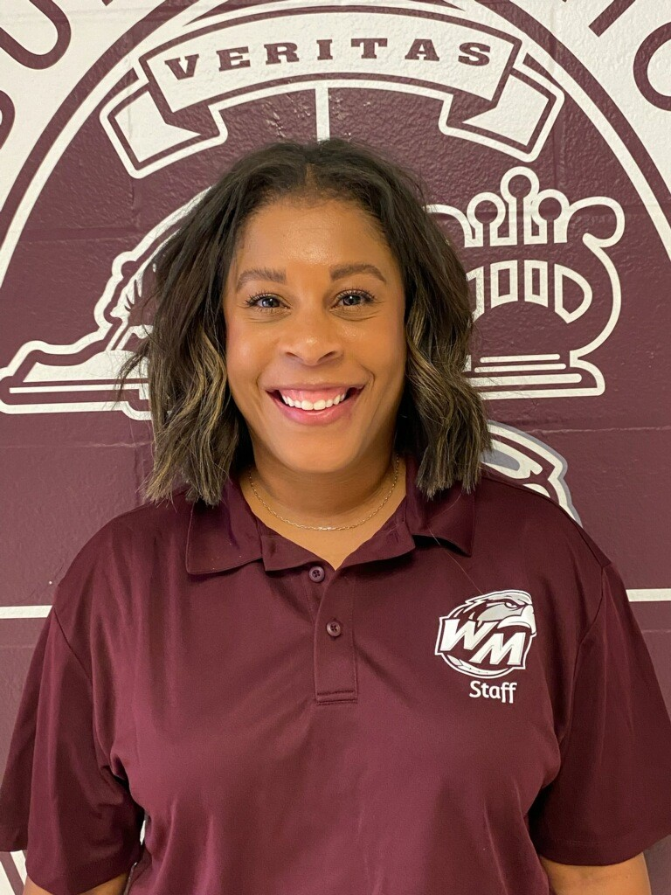
School Counselors
Caseload | School Counselor | Email
A - D | Gertrude Pinckney | gertrude1.pinckney@cms.k12.nc.us
E - Kh | Lauren Bowling | laurene.bowling@cms.k12.nc.us
Student Services Website: https://sites.google.com/cms.k12.nc.us/westmeckstudentservices/home?authuser=0

Slide 11
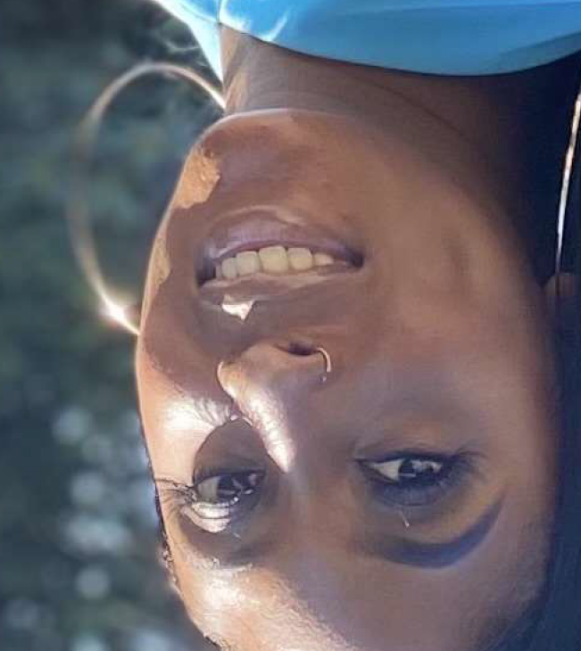
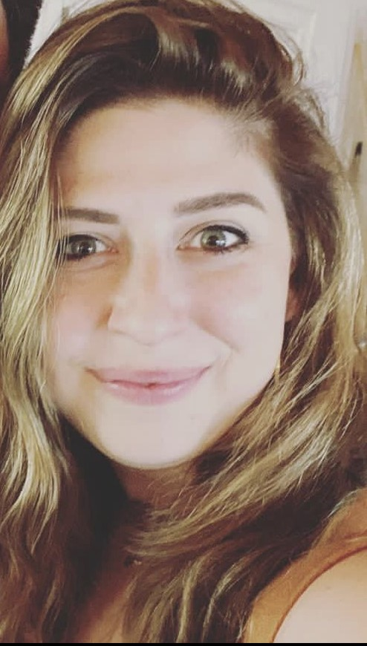
School Counselors
Caseload | School Counselor | Email
Ki - Re | DaQuisha Varner | daquishal.varner@cms.k12.nc.us
Ri - Z | Sivan Levine | sivan1.levine@cms.k12.nc.us
Student Services Website: https://sites.google.com/cms.k12.nc.us/westmeckstudentservices/home?authuser=0

Slide 12
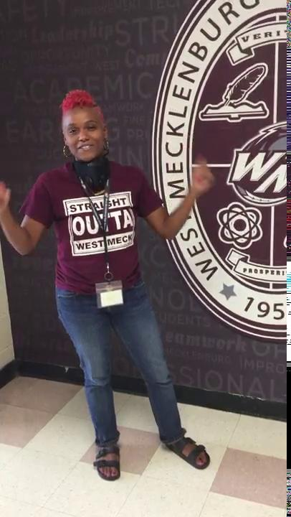
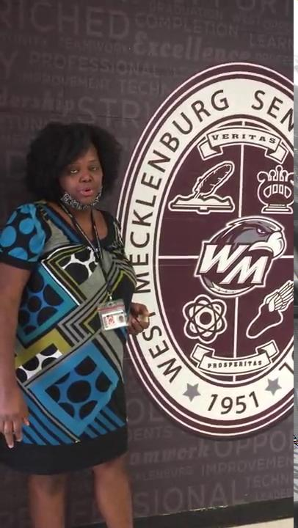
Social Workers
Ms. Gatewood- MCV | Ms. Dillard
denise1.gatewood@cms.k12.nc.us 980-900-9127 West Mecklenburg High School McKinney-Vento Services | cathys.dillard@cms.k12.nc.us 704-426-3934

Slide 13
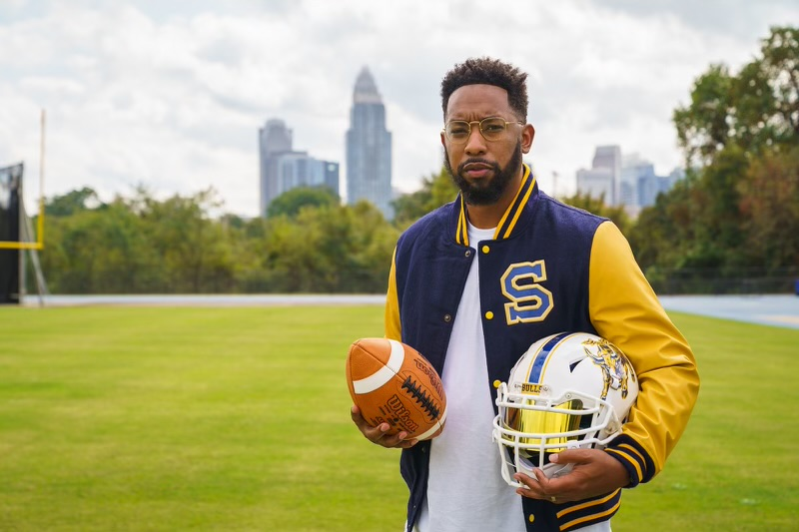
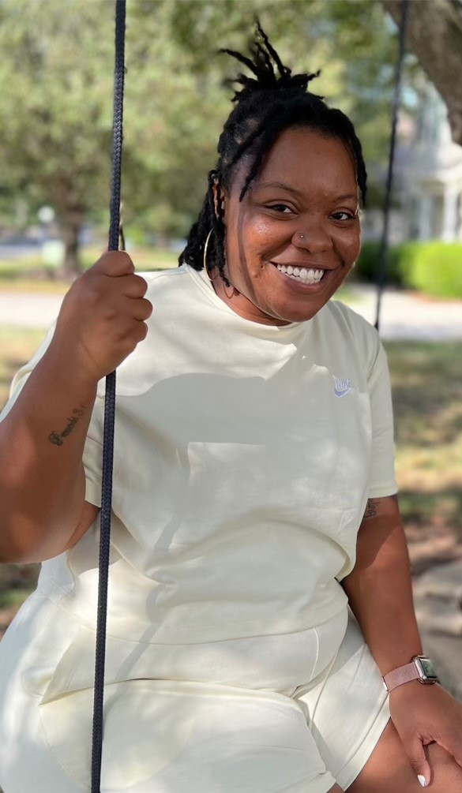
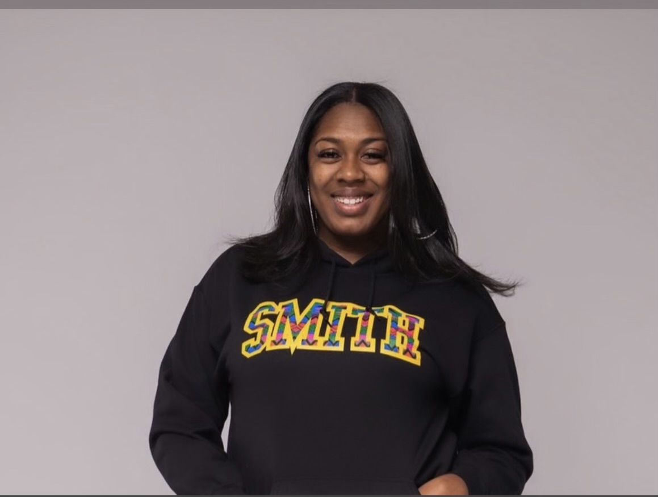
CIS Leaders
Alexis Bibbs | Cortni McKenzie | Qunesha Davis
Parent Contact

Slide 14
Partnerships with West Meck
Elevation
West Mecklenburg Alumni Association
Atrium Health
NAF Advisory Board
ROC
Road to Hire
CPCC
Parent Contact

Slide 15
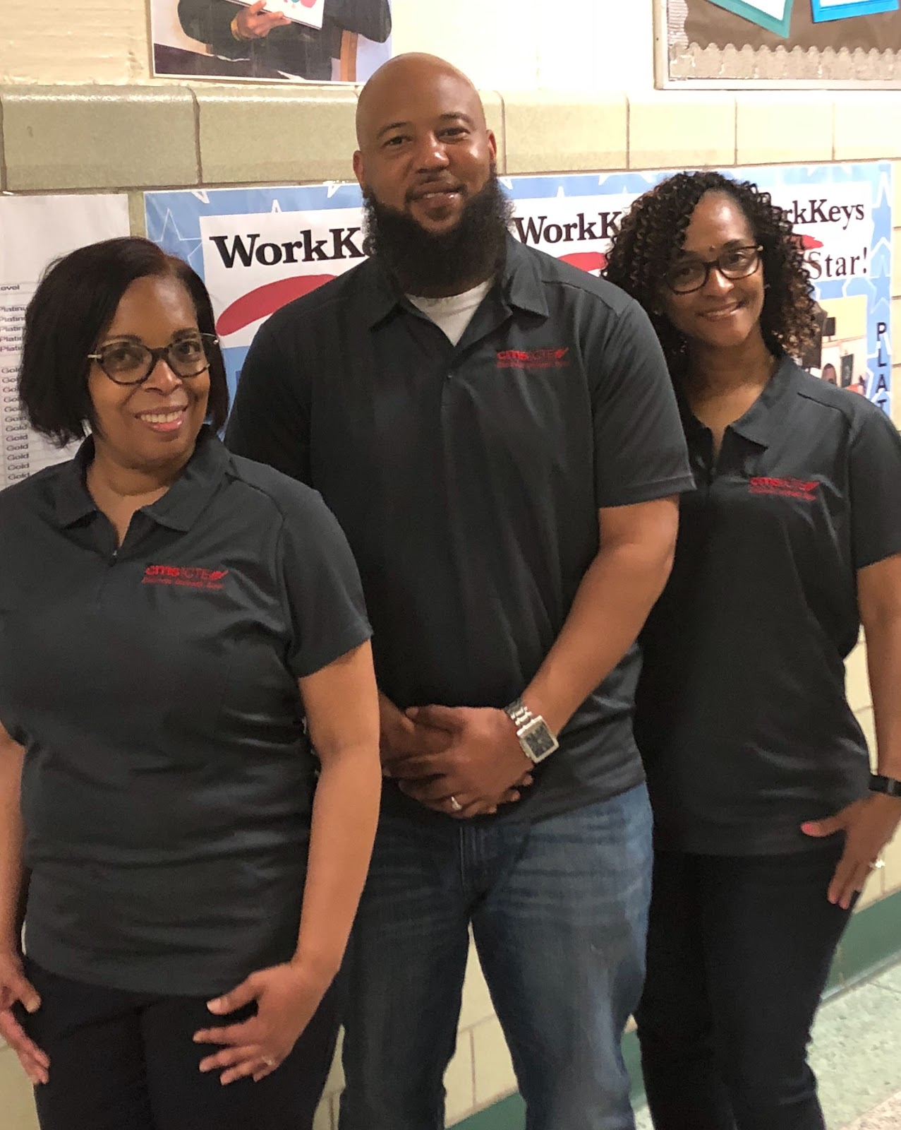
CTE Leaders
Sherri Moore PC | Terrance Daniels CDC | Erinn Edwards IC
Parent Contact

Slide 16
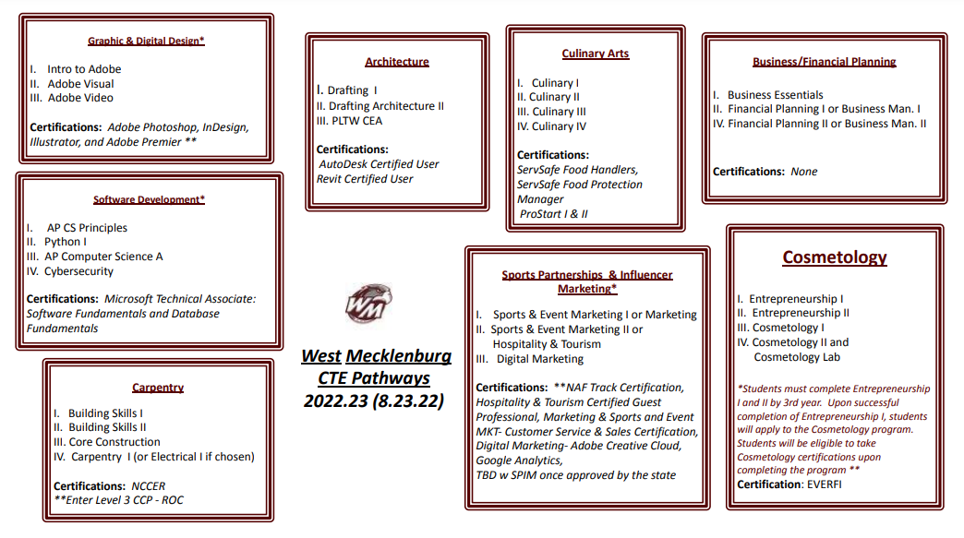
CTE Pathways

Slide 17

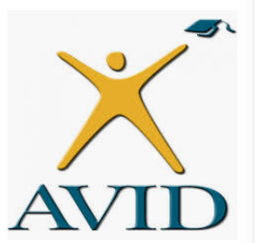


Do You Want to Learn More?
HAWKS
Contacts
Admin: lawrencec.peoples@cms.k12.nc.us
Coordinators: angela1.burke@cms.k12.nc.us
jont.griffith@cms.k12.nc.us
AVID - CAMBRIDGE - EOS
Cambridge

Slide 18
Get Involved… HOW?
PTSA
Booster Club
Student Council
JROTC
Athletics
CIS (Communities in Schools)
Clubs
AVID
Marching Band

Slide 19
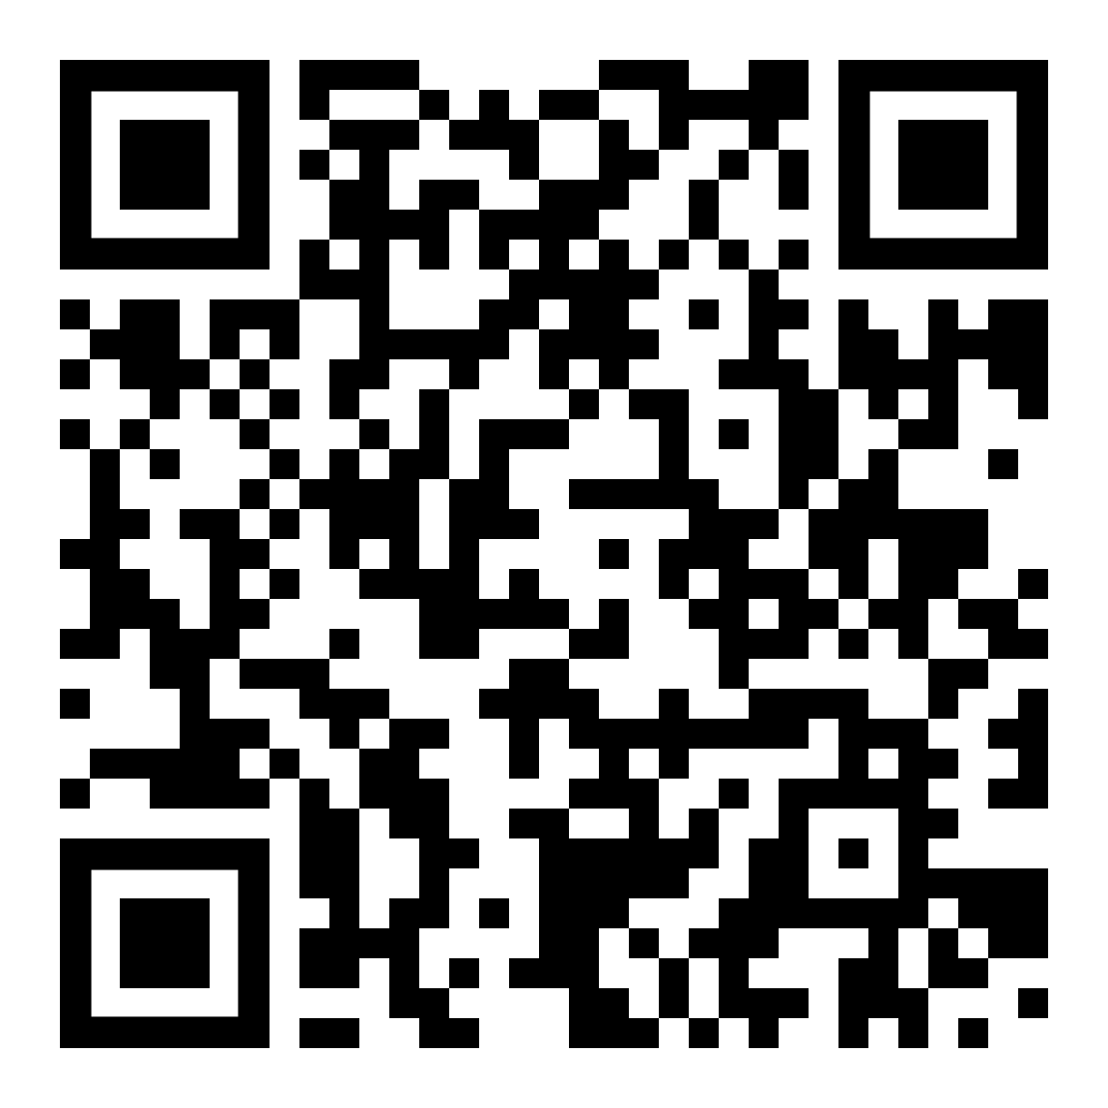
PTSA
Reasons to Get Involved in PTSA
Parent involvement is proven to increase student achievement.
Relationships with your child’s teachers & other parents are built.
Resources are given to help you deal with the struggles of being a high school parent.
Relationships form with people who can help you when you need it.
Your skills can be used to help the school community.
Your voice will be heard by administrators and teachers.
You can make a difference and be a part of the solution!
Education is important. Be a role model showing you agree.
You will be informed of events and activities at school.
You cared in Elementary school,
show your child you still care!!
PTSA Website: bit.ly/wmhsptsa (see welcome letter)
Notes:
Doggett

Slide 20
Marching Band
Interested in Band?
Contact William McLeod
  704-564-4720
  william.mcleod@cms.k12.nc.us

Slide 21
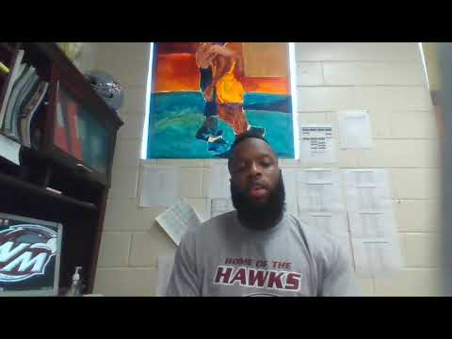
Athletics
ALL Students must complete “Dragonfly”. Link:https://www.westmeckathleticzone.com
Any athlete who has a physical prior to August 1, 2021 will need a new physical for the upcoming 2022-2023 season. (No student is allowed to participate without this document on file.)
Athletics Requirements:
Promotion from the 2021-2022 school year equals eligibility for the 2022-2023 athletic year
6 1st semester minimum courses passed
Seniors are required to take at least 3 classes to be eligible for 2nd Semester sports.
Contact information for Fall Sports coaches:
Head Football Coach- Beady Waddell: beadywaddell@gmail.com
Head Basketball/XC Coach- Timothy Fields: Ryanm.queen@cms.k12.nc.us
Head Men’s Soccer Coach- Axel Rojas: axelarojas@gmail.com
Head Women’s Volleyball Coach- Michelle ROberson: coachmicelle@gmail.com
Head Cheerleading Coach- Naitiayah Latta: nlee34@uncc.edu

Slide 22
JROTC
Staff Contacts:
Col Cowan jamesb.cowan@cms.k12.nc.us
Master Sergeant Saunders
    If you are looking to be a part of something, develop leadership, confidence.
    99.5% graduation rate!!!!
    Not a military recruitment program - it is a leadership development and character building program

Slide 23
Stay informed!
Ensure contact information is up-to-date-- give Social Workers correct information in Auditorium
Follow us on social media
@therealwestmeck on Instagram
Facebook - West Meck
Use our School Website and linktr.ee/therealwestmeck
Parent Contact

Slide 24
WHERE IS MY STUDENT’S SCHEDULE?
In-Person
Visit your homeroom to pick up a copy of your schedule.
Signs with Homeroom locations are posted throughout the building.
You will have approximately 1 hour to walk your schedule. This is not a time for individual teacher meetings. Teacher will review basic course information and individual contact information.
We must clear the campus at the assigned end time to prepare for the next session.
Sign In/Enter Contact Info: tinyurl.com/vwmsignin

Slide 25
Title IX

Slide 26
Charlotte-Mecklenburg Schools (“CMS”) does not tolerate acts of sexual or gender-based harassment. Any student who believes that he or she has been subjected to sexual or gender based harassment, any parent of such a student, or any student who believes that another student is being subjected to sexual or gender-based harassment is encouraged to report the harassment to CMS, specifically to the District Title IX Administrator: Stephanie McKinney, 980-343-9433, titleixcoordinator@cms.k12.nc.us.
CMS is committed to conducting a prompt investigation of any such reports. Counseling and educational resources will be available to students who have alleged harassment and to students accused of sexual or gender-based harassment. Students found to have engaged in acts of harassment or other acts that create a hostile environment may be disciplined including, if circumstances warrant, suspension or expulsion. CMS encourages students, parents, and staff to work together to prevent sexual and gender-based harassment. If you have specific concerns, contact Dean of Students, Daniel Moore at 980-343-6080, daniel1.monroe@cms.k12.nc.us

Slide 27
Transportation
If you registered after Aug 4, you will not have a bus the first week.
Eligible students who are enrolled in CMS by August 4th and have registered for transportation services, should have a stop for the first day of school, Mondayu, August 29th. (Registered means the student has been entered in PowerSchool and requested transportation via the ‘Student Ridership Form’ by 6:00 p.m. on August 4th.)
Students who have moved, had their new address recorded in PowerSchool on August 31st or later, and are eligible for transportation will have their bus stop set by the Transportation Area office through the EveryInfo program. Schools, transportation offices, and call center staff can access the start dates using the EveryInfo program.

Slide 28
Transportation
Common Questions:
What do I do if I have not requested transportation as of today?
If you have not requested transportation follow the directives below.
-Go to CMS Website
-Click the bus
-Transportation forms
-Click 2022-23 student ridership form
What do I do if I have requested but have not received transportation yet?
Check back in with transportation to make sure they still have your information and some will be reaching out to you. The process has been taking 7 - 10 business days to recognize new request.

Slide 29
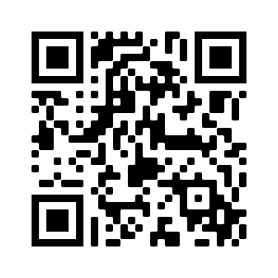
Transportation
If you are here and need bus information, there will be a transportation table set up in the media center.
Use the QR code below to download the “Here comes the bus” app. After going to the link and submitting your children's information you are to enter the code 73877 to begin use.
Issues with transportation (routing issues, etc.)?
West Meck Transportation #: 980-343-6715
Phone 980-343-6715 • Fax 980-343-6723 • www.cms.k12.nc.us

Slide 30



Thank you for being here!
This Photo by Unknown Author is licensed under CC BY
This Photo by Unknown Author is licensed under CC BY

Slide 31
Welcome to the Title I Annual Meeting for Parents & Families
2022-2023
West Mecklenburg High School
August 24, 2022 (In-person)
August 25, 2022 (Virtual)

Slide 32
Why Are We Here?
The Elementary and Secondary Education Act (ESEA), as amended by the Every Student Succeeds Act (ESSA) of 2015, requires that each Title I School hold an Annual Meeting for parents/families/community members for the purpose of:
Informing you of your school’s participation in Title I services
Explaining the requirements of Title I, Part A
Explaining your rights as parents to be engaged

Slide 33
Meeting Overview
What is a Title I school and what it means to be a Title I school
Required Set-Aside for parent and family engagement
The CMS Parent and Family Engagement Policy
How the annual evaluation of the CMS Parent and Family Engagement Policy is conducted
School Parent and Family Engagement Policy
School Improvement Plan (SIP) in NCStar
School-Parent Compact
How to request the qualifications of my child’s teacher(s)
How parents will be notified if my child is taught by a teacher who is not deemed to be qualified by teacher licensing standards in the North Carolina ESSA Accountability Plan

Slide 34
What does it mean to be a Title I School?
Being a Title I school means receiving federal funding (Title I dollars) to supplement the school’s existing programs. These dollars are used for the following:
  Identifying students experiencing academic difficulties and providing timely assistance to help students meet the state’s challenging content standards.
  Purchasing supplemental staff/programs/materials/supplies
  Conducting parent and family engagement meetings/trainings/activities
  Recruiting/Hiring/Retaining Highly-Qualified Teachers
Being a Title I school also means encouraging ongoing parent and family engagement and advocating for parents’ rights

Slide 35
How are Title I funds used in our school?
Hiring additional staff
Interpreter/translator
Parent Involvement
Professional Development for staff
Tutoring services
Supplies and materials (books, technology)

Slide 36
What is the CMS
Parent and Family Engagement Policy?
This policy addresses how the district or LEA will implement the parent and family engagement requirements of the Every Student Succeeds Act (ESSA).
Parents and families in Title I schools have the right to be engaged in the review/evaluation of this annual policy

Slide 37
Parents of students at Title I schools have the right to be engaged in the development of this plan
  Where/How can you access SIP?
www.indistar.org
Guest Username: Guests5949 Guest Password: Guests5949
What is the School Improvement Plan/NCStar Plan?

Slide 38
What is the
School Compact?
The compact is a commitment from the school, the parent/family, and the student, to share in the responsibility for improved academic achievement
Parents and families of students in Title I schools have the right to be involved in the revision/review of the School Compact

Slide 39
Thank you for being here!
This Photo by Unknown Author is licensed under CC BY
This Photo by Unknown Author is licensed under CC BY

